Slide 1

Example: Tree Search
a
G
b
c
d
e
f
S
h
p
q
r
Notes:
Left: show tree
Right: fringe

Slide 2
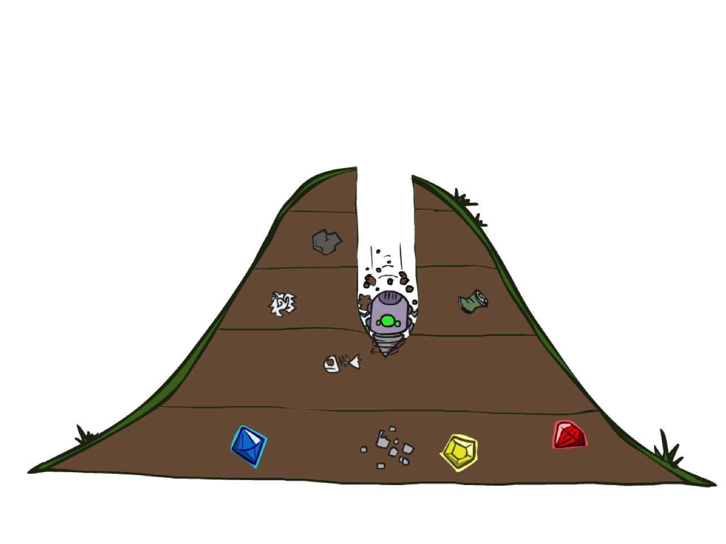
Depth-First Search

Slide 3
Depth-First Search
Strategy: expand a deepest node first
Implementation: Fringe is a LIFO stack
a
G
a
c
b
c
b
e
d
e
d
f
f
S
h
h
p
p
r
q
r
q
S
d
e
p
b
c
e
h
r
q
a
a
h
r
p
q
f
p
q
f
q
c
G
q
c
G
a
a

Slide 4
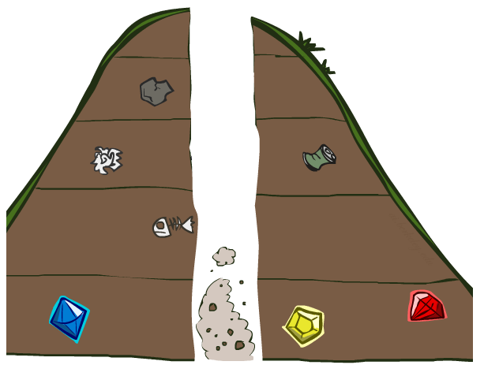
Search Algorithm Properties

Slide 5
Search Algorithm Properties
Complete: Guaranteed to find a solution if one exists?
Optimal: Guaranteed to find the least cost path?
Time complexity?
Space complexity?
Cartoon of search tree:
b is the branching factor
m is the maximum depth
solutions at various depths
Number of nodes in entire tree?
1 + b + b² + …. b^{m} = O(b^{m})
1 node
b
…
b nodes
b² nodes
m tiers
b^{m} nodes

Slide 6
Depth-First Search (DFS) Properties
What nodes DFS expand?
Some left prefix of the tree.
Could process the whole tree!
If m is finite, takes time O(b^{m})
How much space does the fringe take?
Only has siblings on path to root, so O(bm)
Is it complete?
m could be infinite, so only if we prevent cycles (more later)
Is it optimal?
No, it finds the “leftmost” solution, regardless of depth or cost
1 node
b
…
b nodes
b² nodes
m tiers
b^{m} nodes

Slide 7
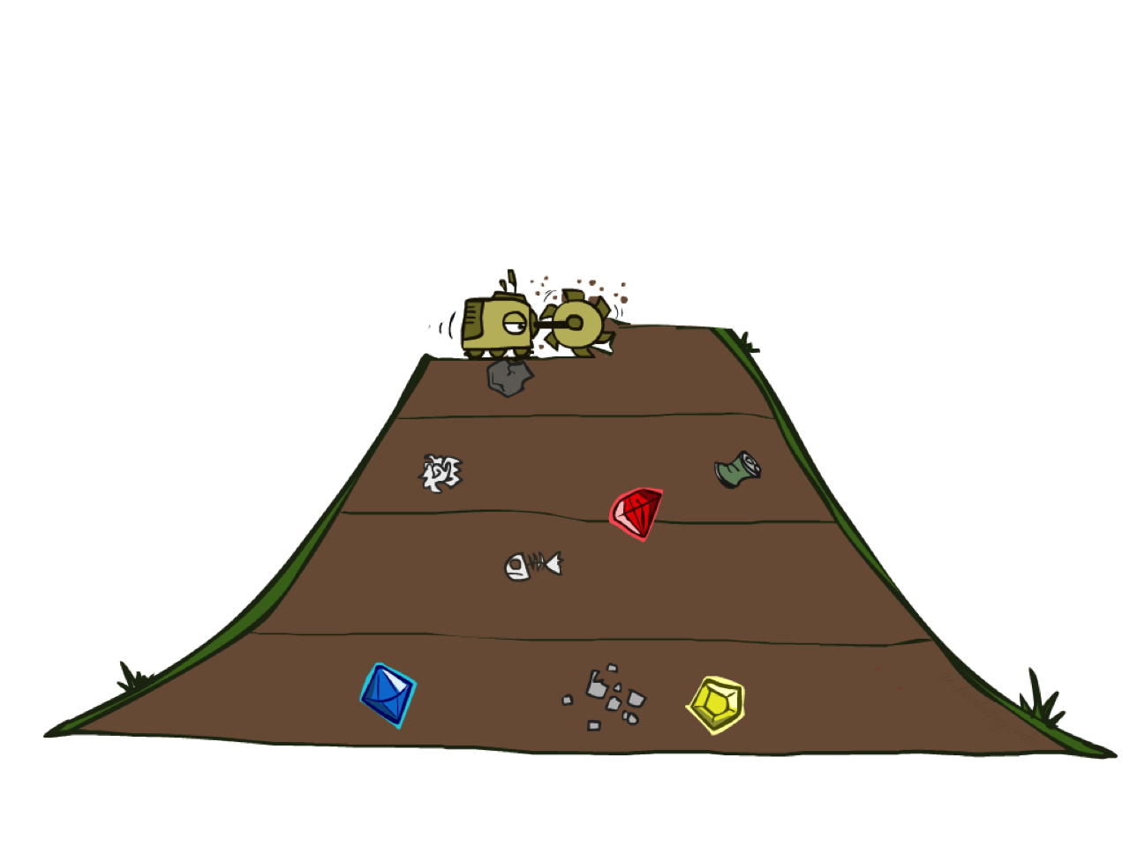
Breadth-First Search

Slide 8

Breadth-First Search
Strategy: expand a shallowest node first
Implementation: Fringe is a FIFO queue
a
G
b
c
d
e
f
S
h
p
q
r
S
d
e
p
Search
Tiers
b
c
e
h
r
q
a
a
h
r
p
q
f
p
q
f
q
c
G
q
c
G
a
a

Slide 9
Breadth-First Search (BFS) Properties
What nodes does BFS expand?
Processes all nodes above shallowest solution
Let depth of shallowest solution be s
Search takes time O(b^{s})
How much space does the fringe take?
Has roughly the last tier, so O(b^{s})
Is it complete?
s must be finite if a solution exists, so yes!
Is it optimal?
Only if costs are all 1 (more on costs later)
1 node
b
…
b nodes
s tiers
b² nodes
b^{s} nodes
b^{m} nodes

Slide 10
Quiz: DFS vs BFS
When will BFS outperform DFS?
When will DFS outperform BFS?

